Slide 1
COMP 3100
Week 15 - Wednesday

Slide 2
Last time
What did we talk about last time?
Review up to Exam 1 and halfway to Exam 2

Slide 3
Questions?

Slide 4
Final exam format
Time: Friday, 12/13/2024, 2:45 - 4:45 p.m.
The exam will have:
  Short answer questions
  At least one matching question
  One or two diagrams or figures you must create
  Two to three essay questions

Slide 5
Review

Slide 6
Software Engineering Design

Slide 7
Simplicity
As with interface design, simpler designs are better
What is simplicity?
  Fewer lines of code
  Fewer control structures
  Fewer connections between different parts
  Fewer computations with different kinds of objects
A good rule of thumb is which design is easiest to understand
Simplicity is a good goal, but some important algorithms in computer science are necessarily complex
Everything should be made as simple as possible, but not simpler.
-Attributed to Albert Einstein, who probably did not say it quite like that

Slide 8
Small modules
Designs with small modules are better
Smaller modules are easier to read, to write, to understand, and to test
Miscellaneous guidelines:
  Classes should have no more than a dozen operations (methods)
  Classes should be no more than 500 lines long
  Operations should be no more than 50 lines long
  I have heard that you should be able to cover a method with your hand
Of course, it is often impossible to follow these guidelines

Slide 9
Information hiding
Each module should shield the internal details of its operation from other modules
Declare variables with the smallest scope possible
Use private (and protected) keywords in OOP languages to hide data (and even methods) from outside classes
Advantages of information hiding:
  Modules that hide their internals can change them without affecting other thins
  Modules that hide information are easier to understand, test, and reuse because they stand on their own
  Modules that hide information are more secure and less likely to be affected by outside errors
This is why we use mutators and accessors instead of making members public

Slide 10
Minimize module coupling
Module coupling is the amount of connectivity between two modules
Modules can be coupled in the following ways:
  One class is an ancestor of another class
  One class has a member whose type is another class
  One class has an operation (method) parameter whose type is another class
  One operation calls an operation on another class
If there two modules have many of these couplings, we say that they are strongly coupled or tightly coupled
When modules are strongly coupled, it's hard to use them independently and hard to change one without causing problems in the other
Try to write classes to be as general as possible instead of tied to a specific problem or set of classes
Using interfaces helps

Slide 11
Maximize module cohesion
Module cohesion is how much the stuff in the module is related to the other stuff in the module
We want everything in a class to be closely related
It's best if a class keeps the smallest amount of information possible about other classes
More module cohesion usually leads to looser module coupling
Sometimes a module being hard to name suggests that its data or operations are not cohesive

Slide 12
Design process
Design Problem
Analyze Design Problem
The design process is a microcosm of the larger software development process
The steps are analyzing the problem, proposing solutions (and looking up existing solutions to similar problems), and evaluating the solutions (perhaps combining different solutions) until a design is selected
Generate and Improve Candidate Designs
Evaluate Candidate Designs
Select Design
Inadequate
Adequate
Design Specification
Finalize Design

Slide 13
Architectural design
Architectural design is specifying a program's major components
Architectural design is often modeled with a box-and-line diagram (also called a block diagram)
  Components are boxes
  Relationships or interactions between them are lines
  Unlike UML diagrams, box-and-line diagrams have no standards
  Draw them in a way that communicates your design

Slide 14
Model-View-Controller
The Model-View-Controller (MVC) style fits many kinds of web or GUI interactions
The model contains the data that is being represented, often in a database
The view is how the data is displayed
The controller is code that updates the model and selects which view to use
The Java Swing GUI system is built around MVC
Good: greater independence between data and how it's represented
Bad: additional complexity for simple models

Slide 15
Layered style
Organize the system into layers
Each layer provides services to layers above it, with the lowest layer being the most fundamental operations
Layered styles work well when adding functionality on top of existing systems
Good: entire layers can be replaced as long as the interfaces are the same
Bad: it's hard to cleanly separate layers, and performance sometimes suffers

Slide 16
Repository style
If many components share a lot of data, a repository style might be appropriate
Components interact by updating the repository
This pattern is ideal when there is a lot of data stored for a long time
Good: components can be independent
Bad: the repository is a single point of failure

Slide 17
Client-server architecture
Client-Server styles are used for distributed systems
Each server provides a separate service, and clients access those services
Good: work is distributed, and clients can access just what they need
Bad: each service is a single point of failure, and performance might be unpredictable

Slide 18
Pipe and filter style
In the pipe and filter style, data is passed from one component to the next
Each component transforms input into output
Good: easy to understand, matches business applications, and allows for component reuse
Bad: each component has to agree on formatting with its inputs and outputs

Slide 19
Detailed Design

Slide 20
More depth on class diagrams
Class diagrams are made up of class symbols (rectangles)
These class symbols contain one or more compartments
The top compartment has the class name
A second, optional compartment often contains attributes (called member variables in Java classes)
  Often followed by a colon with the type
A third, optional compartment often contains operations (called methods in Java classes)
  Sometimes followed by parameter and return types
Visibility modifiers can be marked:
  + for public
  # for protected
  ~ for package
  - for private
Only important attributes and operations need to be specified
  Classes might contain others that aren't shown

Slide 21
Inheritance and interfaces in class diagrams
Inheritance is shown with the generalization connector
  A solid line from the child class to a solid triangle connected to the parent class
  Confusingly, this means that children classes point at their parent classes
Interfaces look like classes but are marked with «interface» above the class name
  This kind of marking is called a stereotype
  Stereotypes show extra information that wasn't part of the original UML class diagram specification
Classes that implement interfaces have dashed lines leading to a solid triangle connected to the interface

Slide 22
Other associations
Associations are show with lines between classes
  Associations can be labeled to explain them
  The lines can be marked with the multiplicity, showing how many of each class can be associated with the other
  The multiplicity can be comma separated lists or ranges, and * means zero or more
When a class is part of another class, the part is connected by a line and a diamond (the aggregation connection) to the whole

Slide 23
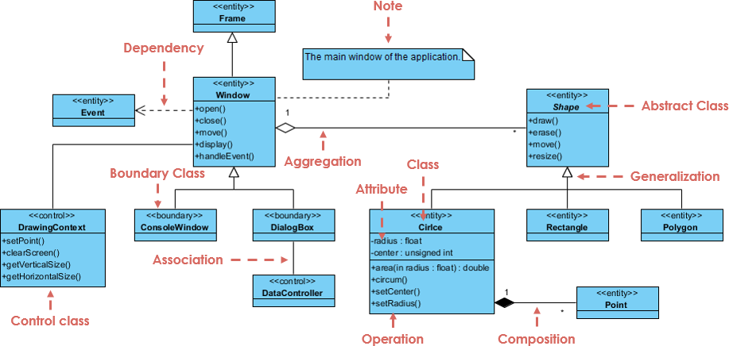
Complex example
From visual-paradigm.com

Slide 24
Design Patterns

Slide 25
Design patterns
Software design patterns are ways of designing objects that have been used successfully in the past
  Think of them as rough blueprints or guidelines
Design patterns have four essential elements:
  A meaningful name
  A description of the problem area that explains when the pattern may be applied
  A solution description of the parts of the design, their relationships, and their responsibilities
  A statement of the consequences of using the design pattern
Patterns are more abstract than code

Slide 26
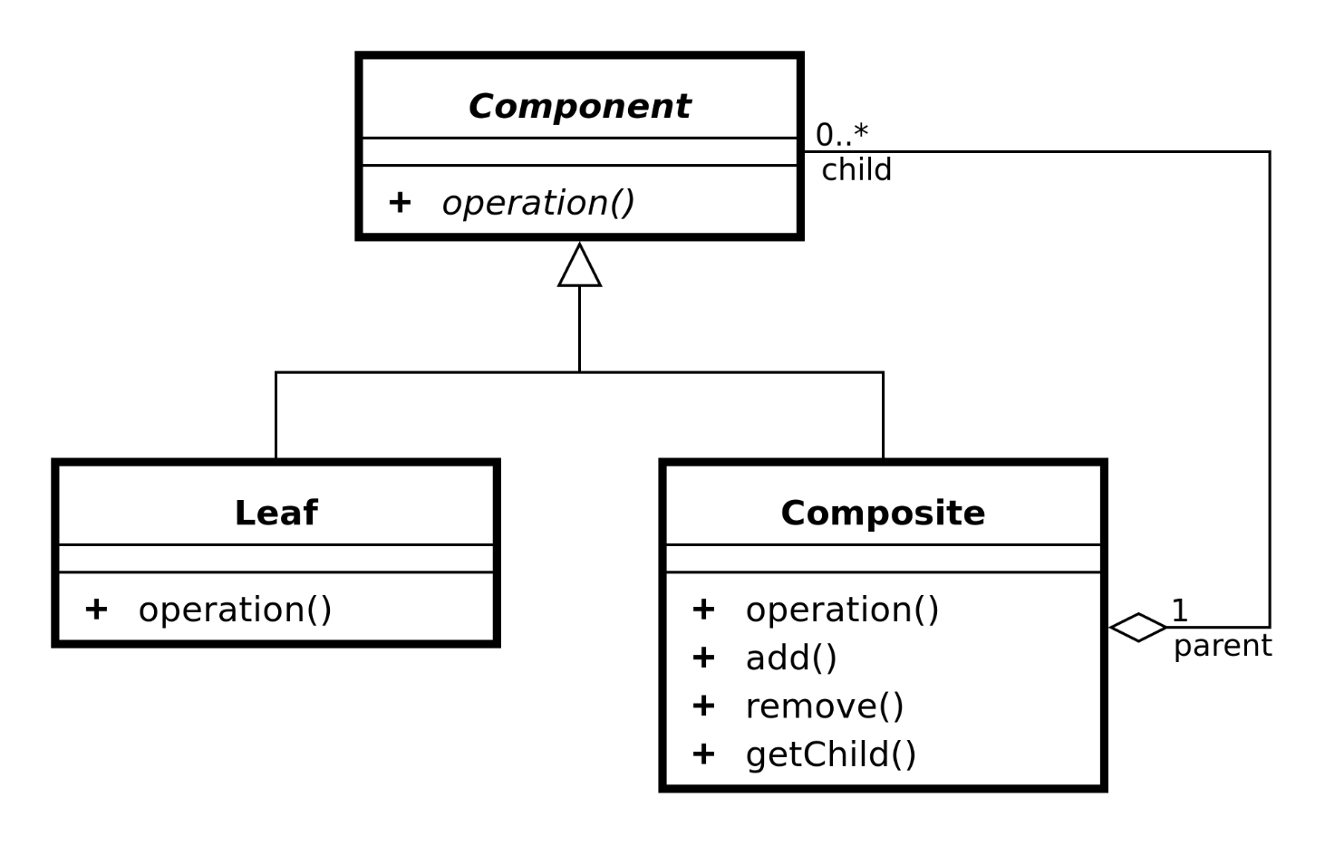
Composite pattern
The composite pattern is useful for part-whole hierarchies of objects
A group of objects somewhere in the hierarchy can be treated like a single object
The Swing library uses the composite pattern for its graphical components
Problems the composite pattern solves:
  Representing a part-whole hierarchy so that clients can treat parts and wholes the same
  Representing a part-whole hierarchy as a tree

Slide 27
Command pattern
The command pattern is useful for encapsulating an action in an object
The action is independent from the objects that used it and can be stored for later
The Swing library uses the command pattern for events
Problems the command pattern solves:
  Decoupling the requester from a request

Slide 28
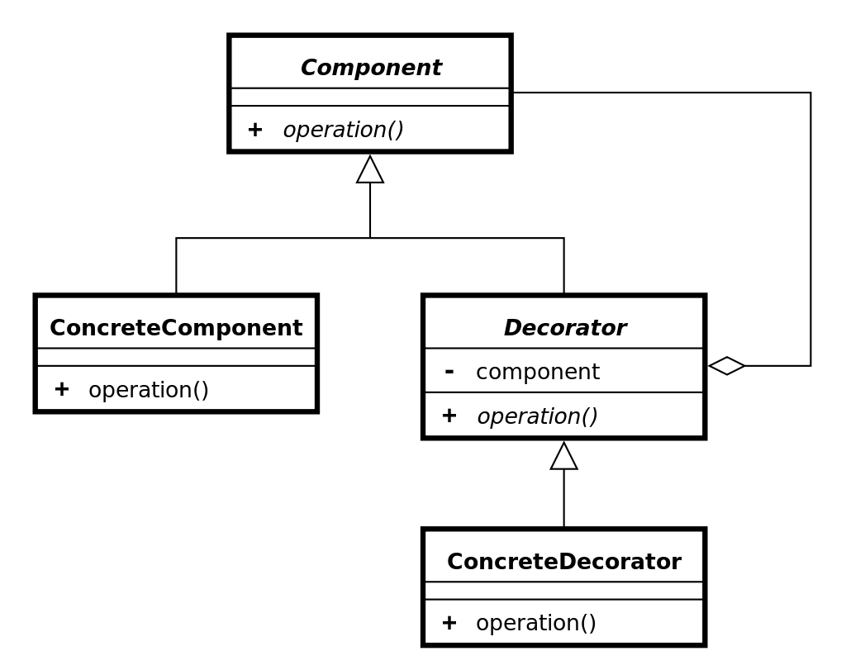
Decorator pattern
The decorator pattern provides a way to add responsibilities to an object dynamically at run-time
It is commonly used to customize the appearance of GUI elements
The Swing library uses the decorator pattern to customize borders
Problems the decorator pattern solves:
  Adding responsibilities to an object dynamically at run-time
  Providing a flexible alternative to inheritance for extending functionality

Slide 29
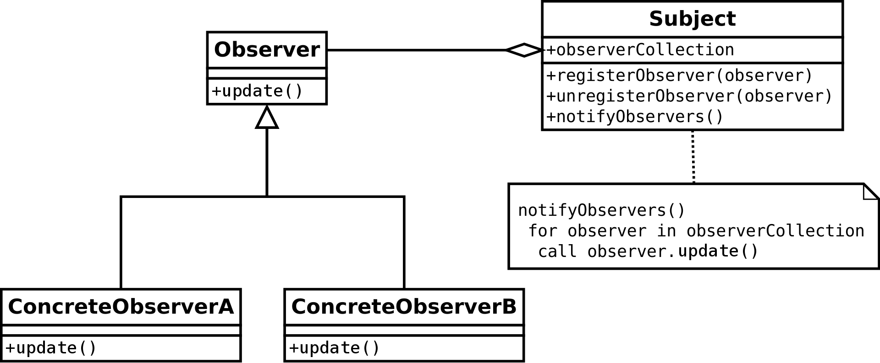
Observer pattern
The observer pattern is useful for a one-to-many dependency where one object changing can update many other objects
An observer pattern defines Subject and Observer objects
When a subject changes state, registered observers are updated automatically
Problems the observer pattern solves:
  Making a one-to-many dependency between objects without tightly coupling the objects
  Updating an arbitrarily large number of other objects automatically when one object changes state

Slide 30
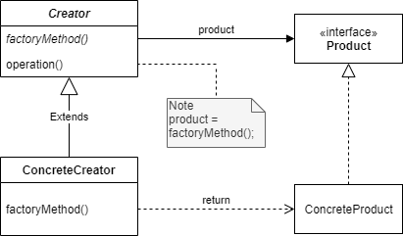
Factory method pattern
The factory method design pattern allows a method to be overridden so that a child class can determine what kind of object to create
A factory method is defined that is used to create objects
Problems the factory method pattern solves:
  Allowing subclasses to define which class to instantiate

Slide 31
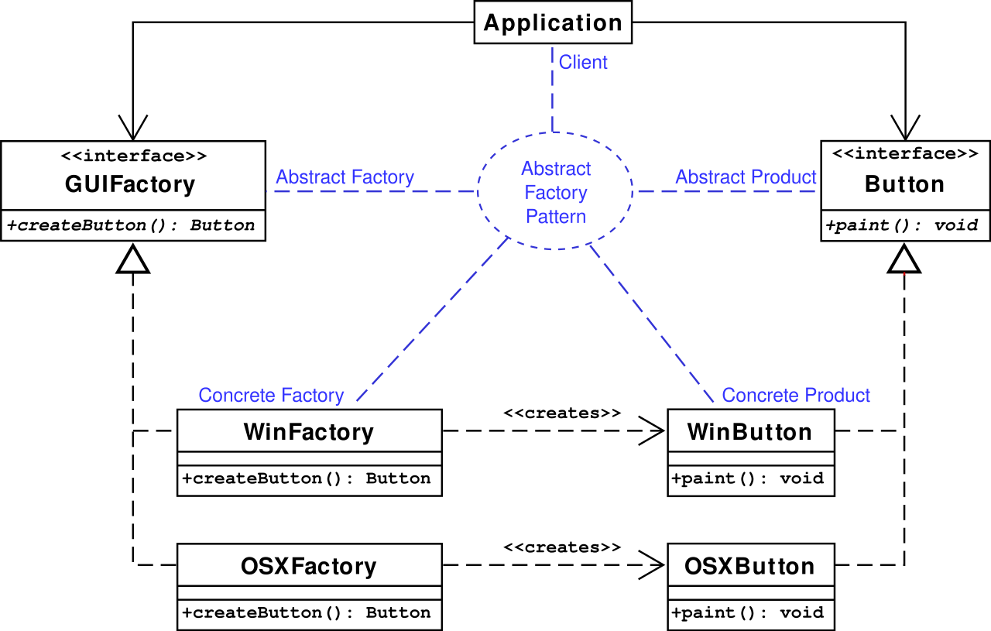
Abstract factory pattern
The abstract factory pattern is similar except that it uses some object as a factory instead of overriding a method
Problems the abstract factory pattern solves:
  Making a class be independent of the objects it requires
  Making a family of related objects

Slide 32
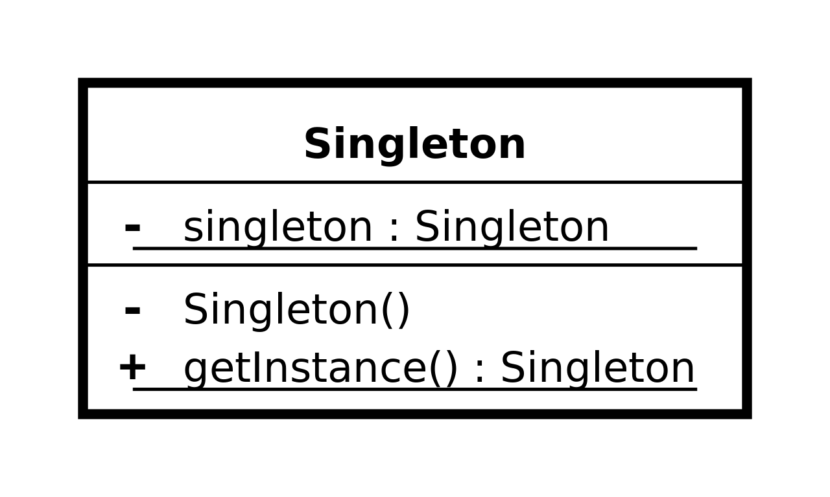
Singleton pattern
Sometimes it's useful to have only a single instance of a class
The singleton pattern makes it so that it's possible to make only one object of a class and makes it easy to access
Problems the singleton pattern solves:
  Ensuring that there's only one instance of a class
  Making the instance of a class easy to get

Slide 33
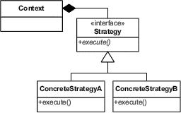
Strategy pattern
The strategy pattern allows an algorithm to be selected at run-time
In Java, that algorithm is usually encapsulated in the method of an object
Problems the strategy pattern solves:
  Configuring a class with an algorithm at run-time
  Selecting or exchanging an algorithm at run-time

Slide 34
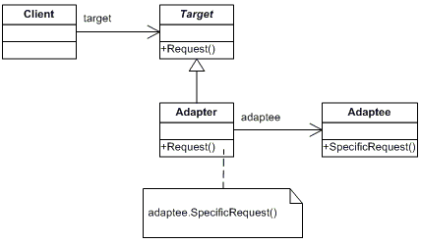
Adapter pattern
Sometimes you have an object that doesn't generate the right kind of output
The adapter pattern allows you to turn the output from something that gives one kind of output into the kind you need
Problems the adapter pattern solves:
  Reusing a class that doesn't have an interface the client requires
  Allowing classes with incompatible interfaces to work together

Slide 35
Construction Techniques

Slide 36
Bought and customized systems
A bought and customized system is one with several bought subsystems that have been customized and integrated into a product that satisfies requirements
Pros:
  Widely used components are usually reliable
  Good documentation and standards exist for using such components
  Constructing these systems is usually faster, and costs are easier to predict
Cons:
  Increased dependency on outside organizations and their support
  Lowered flexibility
  Software engineers have less creative control, potentially reducing job satisfaction (boohoo)

Slide 37
Idioms
Idioms in programming languages are common ways to express ideas
Example Java idioms:
  Use for loops when you want to repeat a specific number of times
  Use while loops when you don't know how much you're going to repeat
  Use a three-line swap to exchange values
It's a good idea to read code in a language you don't know well to figure out the idioms that people use
Some people use idioms from languages they know better that can be either inefficient or confusing if they're not used in a different language
Syntactic sugar is a kind of formalized idiom
  An easy-to-use grammatical structure is converted to a harder-to-read one behind the scenes
  Example: enhanced for loops in Java

Slide 38
Programming style
Each language has stylistic considerations for how to write readable code
  Many workplaces and open source projects publish style guidelines
Naming conventions cover how to name variables, methods, classes, files, packages, etc.
  Spelling matters
  Capitalization is often a matter of convention
  Being consistent makes everything clearer

Slide 39
Naming
Most languages encourage either snake case or camel case
  Snake case breaks up words with underscores: nuclear_silo_radius
  Camel case breaks up words with capitalization: nuclearSiloRadius
  Snake case is common in C and Python
  Camel case is common in Java and C#
  Very few programming languages allow spaces in variable names
I prefer variables to be explicit so that it's clear what we're talking about even if we start reading in the middle of unfamiliar code
  Java tends toward the explicit rather than the abbreviated
A few other Java naming conventions:
  Packages are all lowercase
  Local variables, member variables, and methods start with lowercase letters
  Classes, enums, and interfaces start with uppercase letters
  Constants are written in snake case with ALL CAPS

Slide 40
Layout conventions
Many languages (with the notable exception of Python) ignore whitespace
Thus, we have a choice about how to layout our code
In C-family, curly brace languages, it's common to put the opening brace of an if statement, method, or loop either on the same line as the header (K&R style) or on the next line (Allman style)
  K&R is more common for Java, but Allman is more common for C#
Some people also have strong feelings that indentation should be tabs while others prefer spaces
A common convention is that lines of code should not exceed 80 characters
K&R style
if(raining) {
System.out.println("I'm wet!");
}
Allman style
if(raining)
{
System.out.println("I'm wet!");
}

Slide 41
Good commenting
Do use comments to describe the intent of a complicated piece of code
Do use comments to explain the rationale behind a decision so that people can understand in the future
  Why this way?
  Why not that other way?
Do use comments to reference relevant outside documents
  Explanation of an algorithm
  API documentation page
  Design document with UML diagrams

Slide 42
Questionable commenting
Don't use comments to repeat the code
Be careful about using comments for to-do items and future work
  Especially if it means you don't do the right thing now
It is possible to over-comment, so consider whether the supplemental information is useful
Bad comments that repeat the code
// Increase i by 1
++i;
// Include sales[i] in the total
total = total + sales[i];

Slide 43
Data organization
Programs often include data, but how should it be organized?
Data structures store the data in the program, but the data also needs to be stored between program runs or sent to someone else to use
  Internal data vs. external data
Common data organization approaches
  Markup languages
  Databases

Slide 44
Version control
We already know the value of a version control system (VCS)
Some details:
  A VCS stores items (usually files)
  A version is the set of items after one or more modifications
  A revision is a version stored in a VCS
  A baseline is the first revision
  Storage for revisions is called a repository
  Storing a version in the repository is called checking in or committing
  Retrieving a version from the repository is called checking out or updating
  A checked-out version of an item is a working copy

Slide 45
VCS choices
How do we deal with two or more different people working on the same file and trying to commit them to the same repository?
  File locking: When a files are checked out for modification, they are locked, meaning that no one else can check them out for modification
  Concurrent modification and merge: If someone tries to commit a file based on an older version of the file, the commit fails, forcing the person to merge the newer repository file with the file they're working on
Before you start modifying a file, it's wise to pull down the latest changes first
A centralized VCS has one central repository
A distributed VCS has many repositories that are peers

Slide 46
Quality Assurance in Construction

Slide 47
Static analysis and dynamic analysis
Static analysis is looking at code without running it
  Code reviews
  Syntax checking
  Style checking
  Usage checking
  Model checking
  Data flow analysis
  Symbolic evaluation
Dynamic analysis is running code to test it
  Unit testing
  Debugging
  Performance optimization and tuning
Both static and dynamic analysis are valuable and have different strengths
  Static analysis doesn't require a fully working program
  Dynamic analysis can give real data about things like performance

Slide 48
Code reviews
Desk checking is one form of code review
  Looking over the code
  Executing it by hand (actually computing values)
Formal inspections (discussed earlier) are another
Formal review guidelines
  Don't read more than 200 lines of code per hour when preparing alone
  Don't cover more than 150 lines of code when doing a team inspection
  Use a checklist
Examples from a Java inspection checklist
  All variables and constants are named in accord with naming conventions
  There are no variables or attributes with confusingly similar names
  Every variable and attribute has the correct data type
  Every method returns the correct value at every return point
  All methods and attributes have appropriate access modifiers (private, protected, or public)
  No nested if statements should be converted into a switch statement
  All exceptions are handled appropriately

Slide 49
Formal methods
Formal methods use mathematical models to do static analysis
Model checking uses analysis to determine if a program meets requirements, usually if certain preconditions are met, it's guaranteed that certain postconditions will be met
Data flow analysis represents a program as a graph and uses that knowledge to calculate the possible values at various points in the graph
  Modern languages like Java use data flow analysis to complain, for example, that a variable might not have been initialized
Symbolic evaluation traces through the execution of a program with symbolic values instead of concrete values

Slide 50
Unit Testing

Slide 51
Unit testing
Testing is an important form of dynamic analysis
Unit testing is testing individual units or sub-programs (classes or methods in Java) in isolation
A test case has one value for every input and an expected value for every output
A false negative happens when there's a problem with your code but you don't write a test that catches it
  This almost always happens, since it's very hard to test everything
A false positive happens when your code is fine but your test is bad
  For example, you did the math wrong when coming up with your expected answer

Slide 52
Developing test cases
Picking good test cases is an art form
Black box testing is a strategy that assumes no knowledge of what happens inside the system
  Only what the input and matching output should be are known
  Black box testing is easily done by someone who had nothing to do with developing the code
  Black box testing isn't affected by assumptions about how an algorithm should work
Clear box (or white box or open box) testing uses knowledge of the system to generate good tests
Both kinds of testing are needed to be thorough

Slide 53
Code coverage
Clear box testing is built around the idea of coverage, which is how much of the unit is tested
Coverage can be explore with a control-flow graph (CFG) that shows the possible paths execution could take in a program
  An action node in a CFG is straight-line code with one entry point and one exit point
  A decision node in a CFG is code like an if statement or a loop with multiple exit points
  Arrows show the flow of execution through nodes

Slide 54
Example CFG
calculate(int x, int y)
S1
[else]
S2
[x > y]
int calculate(int x, int y)
{
int a, b;
a = 1; // S1
if (x > y) // S2
{
a = 2; // S3
}
x++; // S4
b = y * a; // S5
if (y <= 0) // S6
{
b++; // S7
}
return b; // S8
}
S3
S4
S5
[else]
S6
[y <= 0]
S7
S8

Slide 55
Kinds of coverage
We say a statement is exercised by a test or a suite of tests if it gets executed
Statement coverage is the percentage of statements exercised by a set of tests
  Example: (x = 1, y = 2) exercises everything except S3 and S7 in the previous CFG, giving a statement coverage of 75%
Branch coverage is the percentage of branch directions taken by a set of tests
  Example: (x = 1, y = 2) covers the else edge from S2 and the else edge from S6, giving a branch coverage of 50%
Path coverage is the percentage of all execution paths that have been taken
  Example: (x = 1, y = 2) takes only one of the four paths from S1 to S8, giving a path coverage of 25%
More coverage is better
It will usually take many tests to get good coverage

Slide 56
Boundary value analysis
Boundary value analysis uses values near the edges of legal limits
  If input must be within a range, create tests just below, at, and just above the endpoints of the range
  If output must be in a certain range, try to pick inputs that generate values around the minimum and maximum of that range
Example: Boundary values for a method that's supposed to accept passwords if they're between 6 and 12 characters inclusive
Input | Length | Case | Valid
"goats" | 5 | Minimum – 1 | False
"wombat" | 6 | Minimum | True
"wombats" | 7 | Minimum + 1 | True
"abracadabra" | 11 | Maximum – 1 | True
"hippopotamus" | 12 | Maximum | True
"administrator" | 13 | Maximum + 1 | False

Slide 57
Other heuristics
A number of other heuristics are commonly used because they often find errors
For single input parameters
  0 (because people forget about 0 or because of division by 0)
  Very large and very small numbers (because of underflow and overflow)
  Character or string versions of numbers (which makes sense in a language like Python or JavaScript but not in Java where type checkers would prevent such thins)
For multiple input parameters
  Equal values for the parameters
  Different relative values (x larger than y, then x smaller than y)
For arrays and collections
  Very small and very large arrays and collections
  Arrays or collections of length 0 and 1
  Arrays or collections that are unsorted, ascending, and descending
  Arrays or collections with duplicated values and with no duplicated values

Slide 58
Regression testing
Something's wrong with your program, so you change your code, what happens?
Data suggests that
  30% of software changes result in one of the three bad outcomes
  On average, bad outcomes occur about 10% of the time
  Faults introduced during bug fixes are harder to find and remove than others
One safeguard is regression testing, running all tests after any software change
  Any time you find a bug, add the test you used to find the bug into your test suite
 | No New Fault Introduced | New Fault Introduced
Fault Corrected | Good | Bad
Fault Not Corrected | Bad | Very Bad

Slide 59
JUnit
JUnit is a popular framework for automating the unit testing of Java code
JUnit is built into IntelliJ and many other IDEs
It is possible to run JUnit from the command line after downloading appropriate libraries
JUnit is one of many xUnit frameworks designed to automate unit testing for many languages
You are required to make JUnit tests for Project 3
JUnit 5 is the latest version of JUnit, and there are small differences from previous versions

Slide 60
JUnit classes
For each set of tests, create a class
Code that must be done ahead of every test has the @BeforeEach annotation
Each method that does a test has the @Test annotation
import org.junit.jupiter.api.*;
public class Testing {
private String creature;
@BeforeEach
public void setUp() {
creature = "Wombat";
}
@Test
public void testWombat() {
Assertions.assertEquals("Wombat", creature, "Wombat failure");
}
}

Slide 61
Assertions in JUnit tests
When you run a test, you expect to get a certain output
You should assert that this output is what it should be
JUnit 5 has a class called Assertions that has a number of static methods used to assert that different things are what they should be
  Running JUnit takes care of turning assertions on
The most common is assertEquals(), which takes the expected value, the actual value, and a message to report if they aren't equal:
  assertEquals(int expected, int actual, String message)
  assertEquals(char expected, char actual, String message)
  assertEquals(double expected, double actual, double delta, String message)
  assertEquals(Object expected, Object actual, String message)
Another useful method in Assertions:
  assertTrue(boolean condition, String message)

Slide 62
Assertion example
We know that the substring() method on String objects works, but what if we wanted to test it?
import org.junit.jupiter.api.*;
public class StringTest {
@Test
public void testSubstring() {
String string = "dysfunctional";
String substring = string.substring(3,6);
Assertions.assertEquals("fun", substring, "Substring failure!");
}
}

Slide 63
Sometimes failing is winning
What if a method is supposed to throw an exception under certain conditions?
It should be considered a failure not to throw an exception
The Assertions class also has a fail() method that should never be called
import org.junit.jupiter.api.*;
public class FailTest {
@Test
public void testBadString() {
String string = "armpit";
try {
int number = Integer.parseInt(string);
Assertions.fail("An exception should have been thrown!");
}
catch(NumberFormatException e) {}
}
}

Slide 64
Debugging

Slide 65
Debugging
Debugging is using trigger conditions to identify and correct faults
Steps of debugging
  Stabilize: Understand the symptom and trigger condition so that the failure can be reproduced
  Localize: Locate the fault
    Examine sections of code that are likely to be influenced by the trigger
    Hypothesize what the fault is
    Instrument sections of code (with print statements or conditional breaks)
    Execute the code, monitoring the instrumentation
    Prove or disprove the hypothesis
  Correct: Fix the fault
  Verify: Test the fix and run regression tests
  Globalize: Look for similar defects in the rest of the system and fix them

Slide 66
Debug code
Debug code is temporary output and input used to monitor what's going on in the code
Instead of printing out just numbers, add context information so that the debug statements are clear
Debug code is quick and dirty, useful when setting break points and tracing execution with a debugger might be too much work to catch a small issue
There are logging tools that can print logging data at various levels
  Normally, nothing prints out
  Running the program in logging mode prints out important data
  Running the program in verbose mode prints out everything it can
Debug output can go to stdout or stderr
  System.err (instead of System.out) prints to stderr in Java

Slide 67
Debuggers
IntelliJ, Eclipse, Visual Studio, gdb and most fully-featured IDEs provide debugging tools
Typical debugging features:
  Setting breakpoints that will pause execution of the program when reached
    Breakpoints can often be conditional, pausing only if certain conditions are met
  Executing lines of code one by one, stepping over method calls or stepping into them and stepping out when you're done executing its code
  Setting watches that display the current state of variables and members
If you don't use your debugger, you're choosing to play the game with one hand tied behind your back

Slide 68
Refactoring
Refactoring means changing working code into working code
It can be done to improve the structure, the presentation, or the performance
You should refactor when:
  There's duplication in your code
  Your code is unclear
  Your code smells:
    Comments duplicate code
    Classes only hold data (instead of operating on it)
    Information isn't hidden
    Classes are tightly coupled
    Classes have low cohesion
    Classes are too large
    Classes are too small
    Methods are too long
    switch statements are used instead of good object-orientation

Slide 69
Common refactoring actions
Renaming a variable or method
Adding an explanatory variable
  If an expression is too long, storing a partial computation into a named variable can help it be understood
Inline temporary variable
  If a temporary variable is useless, just use the full expression (the opposite of the previous)
Break a method into two methods
Combine two short methods into a single one
Replace a conditional with polymorphism
  Instead of an if or a switch, behavior changes because different objects have overridden methods with different behavior
Move methods from child classes to parent classes

Slide 70
Test driven development
Test driven development (TDD) is a style of development where testing is an integral part of coding
The key idea of TDD is that you write tests for the code before you write the code
  Thus, the tests aren't distorted by writing the code
TDD is used for Extreme Programming, but it can be used for any approach, agile or plan-driven

Slide 71
Principles of TDD
Write Tests
You have to have a testing framework
Tests are written before code
Tests and code are written incrementally
  Write tests for some functionality, then write code to pass them
Code is only written to pass tests
  "Doing the simplest thing that could possibly work"
Refactoring is expected
  Writing code only to pass tests might end up with funky design
[unit incomplete]
Run Tests
[pass]
[not pass]
[unit complete]
Refactor
Write Code to Pass Tests

Slide 72
Benefits of TDD
By making the test first, you really understand what you're trying to implement
Your testing has better code coverage, testing every segment of code at least once
Regression testing happens naturally
Debugging should be easier since you know where the problem likely is (the new code added)
The tests are a form of documentation, showing what the code should and shouldn't do

Slide 73
System Testing

Slide 74
System testing
System testing is testing of the whole product
  Both unit testing and integration testing of individual classes and larger components should have been done by now
  Testing both functional and non-functional requirements
System testing is necessary because:
  There could still be faults in the components
  Some things can't be fully tested without all the pieces together
Alpha testing is the first stage of system testing
  Developers test behavior similar to what real users would do
Beta testing has real users testing the product

Slide 75
Details of system testing
Alpha testing and the two phases of beta testing are similar, but there are some details that are different, summarized in this table
 | Alpha Testing | Beta Testing
 |  | Acceptance Testing | Installation Testing
Personnel | Testers | Users | Users
Environment | Controlled | Controlled | Uncontrolled
Purpose | Validation (Indirect) and Verification | Validation (Direct) | Verification
Recording | Extensive Logging | Limited Logging | Limited Logging

Slide 76
Functional alpha testing
Functional alpha testing is based on the requirements listed in the product specification
To isolate failures, basic functionality is tested before more complex functionality
Operational profiles give information about how often different use cases come up and the typical order of use cases
  Using these profiles, testers can make tests that simulate typical usage

Slide 77
Non-functional alpha testing
Some non-functional requirements are development requirements
  Cost of the product
  Time the product takes to be made
Development requirements generally can't be tested, but there are many kinds of non-functional execution requirements that are testable
Common non-functional execution tests:
  Timing tests time the amount of time needed to perform a function, sometimes using benchmarks, standard timing tests
  Reliability tests try to determine the probability that a product will fail within a time interval: mean time to failure
  Availability tests try to determine that probability that a product will be available within a time interval: percent up time
  Stress tests try to determine robustness (operating under a wide range of conditions) and safety (minimizing the damage from a failure)
  Configuration tests check the product on different hardware and software platforms

Slide 78
User interface tests
Some user interface tests straddle the line between functional and non-functional
Tests that check the user interface are called usability tests or human factors tests
Internationalization or localization tests are a kind of usability test that check translations and other cultural information like currencies and the formatting of numbers, times, and dates
Accessibility tests check whether the user interface works for all people, even with significant disabilities
  There are guidelines for the kinds of disabilities that need support (low visual acuity or color blindness)
  Testing often involves measuring the time needed to perform tasks

Slide 79
Beta testing
Beta testing uses external testers, usually users from the population who will use your product
These users have the duty to record and report failures
Acceptance testing is a kind of beta testing done by clients to validate that the product meets their needs
  Done in a controlled environment, like the one alpha testing was done in
Installation testing is a kind of beta testing using real users in uncontrolled environments
  Instead of validation, the goal is to verify that the product works properly in a (more) real environment
  Installation testing can be inefficient, since the users often do not give the most detailed feedback

Slide 80
Deployment, Maintenance, and Support

Slide 81
Deployment, maintenance, and support
The product has been designed, constructed, and tested…now what?
Users will actually use the product in the production environment, the hardware and software systems where the product lives
Making the product available in the production environment is called deployment
Help that the developer (or their associates) provide to the user is called support
Changes to the software after deployment are called maintenance

Slide 82
Physical architecture
Physical architecture is how the program lives in a file system and executes on processors
  As opposed to logical architecture, what we considered before
Physical architecture can be structured by where it's installed, where it's executed, and where the data is uses is stored
The following four categorizations are common:
  Personal: Software is installed and executed on a user device, where the data is
  Shared: Software is installed on a shared device and temporarily loaded on the user device where it is executed on user data
  Mainframe: Software is installed and executed on a shared device accessible from a user device (terminal) using data stored on the shared device
  Cloud: Software is installed on a shared device and temporarily loaded on the user device where it is executed using data stored on the shared device

Slide 83
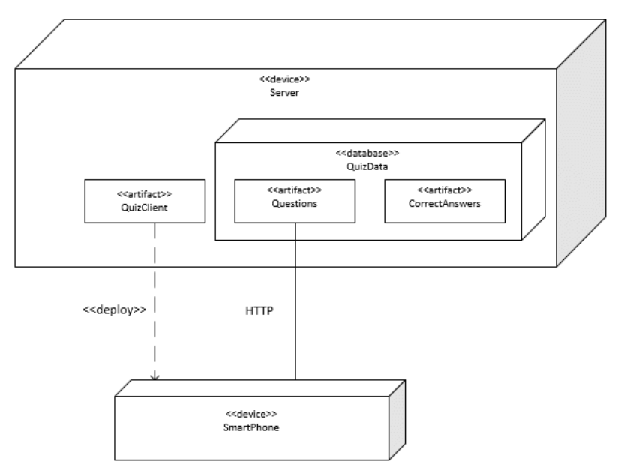
Modeling physical architecture
Like logical architecture, physical architectures can be modeled using UML
UML deployment diagrams contain artifacts and nodes
  Artifacts are physical components like files
    Represented as rectangles with the stereotype «artifact» or an icon
  Nodes are physical devices or execution environments like an operating system
    Represented as boxes with the stereotype «device», «execution environment», or some other description
  Communication between nodes is shown with a solid line
  The deployment relationship is show by putting the artifact in the node box, listing the artifacts in the node box, or using a dashed arrow with the stereotype «deploy»

Slide 84
Deployment
Deployment has the following steps
  Release: Assembling the artifacts into a distributable package (like a zip file or an installer tool)
  Install: Bringing the distributable package to the production environment and putting the artifacts in the right nodes
  Activate: Start the executable artifacts
Ideally, the installation and activation appear to be atomic
  They happen as if they are a single activity
  They can be rolled back to the state before the installation

Slide 85
Distribution channels
Distribution has changed over time
Once upon a time, someone with significant technical skill was needed to install software by hand
Later, executable installers could be bought on disk or downloaded from the Internet
Stores are now a common way to automatically install and update software
  Examples: Apple Store, Windows Store, Steam
Package managers are used for open source software
  Examples: apt, rpm, dpkg, yum
Containers like Docker are also used to provide software in a customized execution environment, ready to use

Slide 86
Maintenance
Maintenance is a change to software after it's been deployed
  Corrective maintenance: Changes that fix faults after they have given rise to failures
  Preventative maintenance: Changes that correct faults before they give rise to failures (or to improve other characteristics like portability)
  Adaptive maintenance: Changes that keep the product usable in a changing environment
  Perfective maintenance: Changes that satisfy additional functional or non-functional requirements
Since products are constantly changing in agile, it's not always clear what's maintenance and what's just another cycle of development

Slide 87
Cost of maintenance
Maintenance is expensive
  Some studies suggest that maintenance is responsible for 80% of the total effort surrounding a software product
  This is exactly why Microsoft pushes OS versions off the supported list as soon as it can
Maintenance is expensive for many reasons:
  It goes on for a long time, maybe decades
  Software is poorly written to begin with, and maintaining only gets harder if new features are added
  Software structure deteriorates over time as changes are made
  In traditional processes, maintenance can take a long time and still end up with a bad result
Agile processes overcome some of these issues by making maintenance a natural continuation of development

Slide 88
Support
Support are the activities between the user and a developer (or representatives of the developer) to help the user's experience
Support is often put into two categories
  Professional support: The person providing support is employed by or paid by the developer
  Community support: The person providing support is another user or expert not employed by the developer
Even professional support is usually not provided by the developers themselves
  Support teams usually have lower skills and are paid less
  Developers might not have the *ahem* interpersonal skills to deal with frustrated users
  Support teams often have better knowledge of the application domain (the thing the product is being used for)

Slide 89
Task Identification and Effort Estimation

Slide 90
Task identification and organization
High level tasks are pretty easy to identify
  "Add networking support"
But that level of detail isn't very useful
Tasks are either:
  Non-decomposable, also called actions
  Decomposable, also called activities or processes
The right level of detail is called a work package
  A work package is a task that is small enough and detailed enough to estimate

Slide 91
Work breakdown structure
A work breakdown structure (WBS) can be used to map out tasks at the right level of abstraction
  The book prefers hierarchy diagrams to represent a WBS, since they balance the readability of trees with the space efficiency of hierarchical lists
Nodes in a WBS are work to be done
The root of a WBS is the project name
The first level is all the deliverables for a project
Each level below represents more and more detailed work
Leaf nodes are work packages

Slide 92
WBS example
The hierarchy diagram to the right shows a WBS for a home security product
Note that different strategies can be used to decompose the work, especially at different levels:
  Project deliverables
  Product features or services
  Project phases
  Organizational units
  Physical product decomposition
  Logical product decomposition
  Geographical location of team members

Slide 93
WBS heuristics
But how do you know if you've done a good job breaking things down?
One hundred percent rule: Nodes descended from a parent represent 100% of the work of the parent
  Nothing's left out
  No work is from outside the project
Mutually exclusive siblings: No sibling nodes have overlapping work
8 / 80 rule: Work packages (the leaves) take between 8 and 80 person-hours of effort
  Work in that range (one day to two weeks) can be estimated reasonably well
Get your project team and stakeholders together and make your WBS on a whiteboard

Slide 94
Effort estimation in traditional processes
In traditional processes, effort estimation can be done in a few ways:
  Analogy: Is your project like another project? It should take about the same effort
    Problem: Only works if your project is very similar to another project
  WBS to effort: Estimate the effort for each work package in a WBS and add them up
    Problem: It's really hard to estimate effort accurately
  Size to effort: Estimate the size of the final software product and use some math to predict how much work it will take to make the product
    Problem: Oh, so many problems, which we'll discuss

Slide 95
Measuring size
Functional measures of size have to do with how much functionality the program provides
  Number of pages on a website
  Number of reports in a database
  Number of windows in a GUI
Non-functional measures of size are based on the program's structure
  Lines of code
  Number of classes
Non-functional measures are easy to measure after development but hard to predict ahead of time

Slide 96
Lines of code
Lines of code (LOC) is a count of the lines of code needed for a project
  LOC is the most popular non-functional measure of size
Some people prefer source lines of code (SLOC), ignoring whitespace (and perhaps comments)
  It's even possible to weight some lines
  LOC is only meaningful in context, since some programming languages tend to take more LOC to get the same job done
Estimating LOC is done by breaking the product design into smaller and smaller components until the size of each component can be estimated
Accuracy is hard to achieve early on, since there isn't even a design yet
"Measuring programming progress by lines of code is like measuring aircraft building progress by weight."
-Bill Gates

Slide 97
Function points
Alternatively, a functional measure of size is possible called function points
Function points are calculated by looking at five different types of components, organized into two categories:
Processes or Transactions
  External Inputs (EI): Processes that provide data that will be used or stored by the product
  External Queries (EQ): Processes that retrieve stored data
  External Outputs (EO): Processes that provide derived information to a user (performing calculations)
Data Storage
  Internal Logical Files (ILF): Groupings of data maintained by the product
  External Interface Files (EIF): Groupings of data external to the product but used by the product

Slide 98
Effort estimation
All these estimates of size give us some arbitrary number, but how much effort is needed?
Algorithmic cost models try to turn size estimates into a measure of effort called the person-month
  The amount of effort a normal developer does in one month
  Each person month has about 22 person-days
  Effort covers all work from requirements, design, coding, testing documentation, collecting data, management, and so on

Slide 99
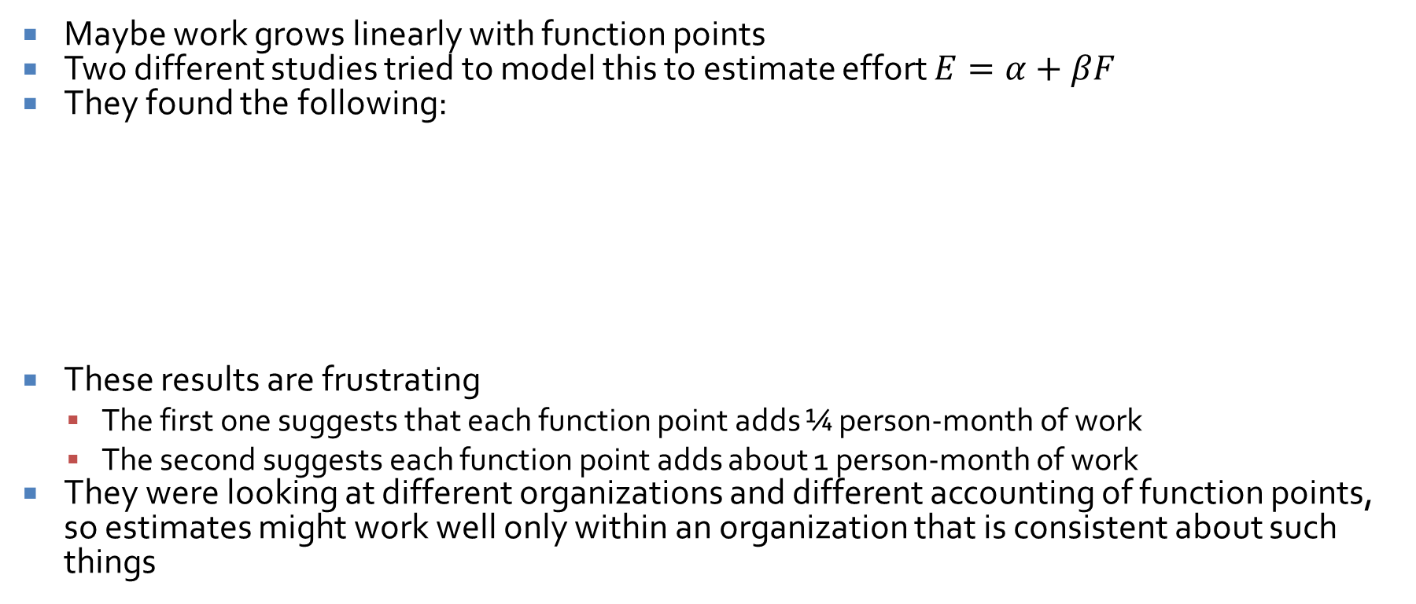
Simple models
Maybe work grows linearly with function points
Two different studies tried to model this to estimate effort $E=α+βF$
They found the following:
These results are frustrating
  The first one suggests that each function point adds ¼ person-month of work
  The second suggests each function point adds about 1 person-month of work
They were looking at different organizations and different accounting of function points, so estimates might work well only within an organization that is consistent about such things
Study | α | β
Albrecht and Gafney | -91.4 | 0.255
Kemerer | -37.0 | 0.960

Slide 100

Exponential models
Alternatively, some researchers have looked at exponential models relating thousands of lines of source code (KLOC) to total effort using the following equation, where L is KLOC:
  $E=α∙L^{β}$
Results found the following values of α and β:
Note here that β < 1 means economies of scale (time per line of code decreases at the project grows) while β > 1 means the opposite
Study | α | β
Watson and Felix | 5.20 | 0.91
Basili and Freburger | 1.38 | 0.93
Boehm | 3.20 | 1.05

Slide 101
Effort estimation in Scrum
Everything we said before was about waterfall estimates
Scrum skips size estimates and goes straight for effort estimates
As you know, units of effort in Scrum are called story points (or sometimes task points)
  Story points are relative units
  They're based on some of the smallest tasks, using them as a baseline of 1 story point
  Everything is estimated relative to those
Story points aren't used for epics since they're too big and abstract
As PBIs get refined, their effort estimate gets refined too
By the time they're sprintable, they need a relatively accurate story point estimate
This means that there are good estimates for sprintable stories but no estimates for how much work the whole project will take

Slide 102
Detailed estimation in Scrum
What if members of the team disagree on the story points needed for several stories?
Agreement is needed for the sake of fairness and to plan how much work can actually get done in a sprint
Planning poker is a way to bring the team to consensus about the relative difficulty of user stories
Its goal is accuracy (ranking the stories by true difficulty) rather than precision (getting true estimates of how long things will take)
  It's really hard to get true estimates, but it's good to know which stories take more work

Slide 103
Planning poker
First, the team decides what numbers to use as estimates
The numbers are usually sequences that grow exponentially, written on cards
  Modified Fibonacci: 1, 2, 3, 5, 8 ,13, 20, 40, 100
  Powers of two: 1, 2, 4, 8, 16, 32, 64
  This means that large stories won't be estimated precisely, but that's okay
Planning poker has rounds
  Each round estimates the effort for one PBI
  Each team member throws in one card to show her effort estimation
  If all cards match, the value is the estimate
  If they don't match, the team discusses their estimates, focusing on the highest and lowest estimators
  Repeat the round until consensus is reached
It usually only takes a couple of rounds to reach consensus
Estimates are usually pretty good because of discussion

Slide 104
Financial and Economic Planning

Slide 105
Finances matter
There are three software planning activities where finances are particularly important
Buy or lease decision
  Should software or hardware be bought or leased?
  Will it cost more or less to use open-source software over time?
Make or buy decision
  Should software be written from scratch or bought?
Go or no-go decision
  Should a project (especially a software development project) be done or not?
  If the project is already running but there are issues, should it be continued?

Slide 106
Financial conventions
Assets are good things
Liabilities are bad things
Even so, for reasons best known to business people, debt is sometimes listed as an asset
  Take an accounting course if you want to go deep into this
We will look at money from some actor's perspective
  Assets like deposits and revenues will be positive
  Liabilities like costs and rental payments will be negative

Slide 107
Time value of money
Money seems simple, but a lot of the madness business people talk about boils down to a question:
  Would you rather be given $100 today or $110 a year from now?
A similar question is:
  Should you spend $1,000 now to prevent a security hole that is likely to cost your business $10,000 over the next 10 years?
The answer to both of these questions is:
  It depends.
You cannot answer these questions without considering what else you would be doing with the money over the time periods in question
Money doesn't simply sit around: it can be invested with the chance to grow over time

Slide 108
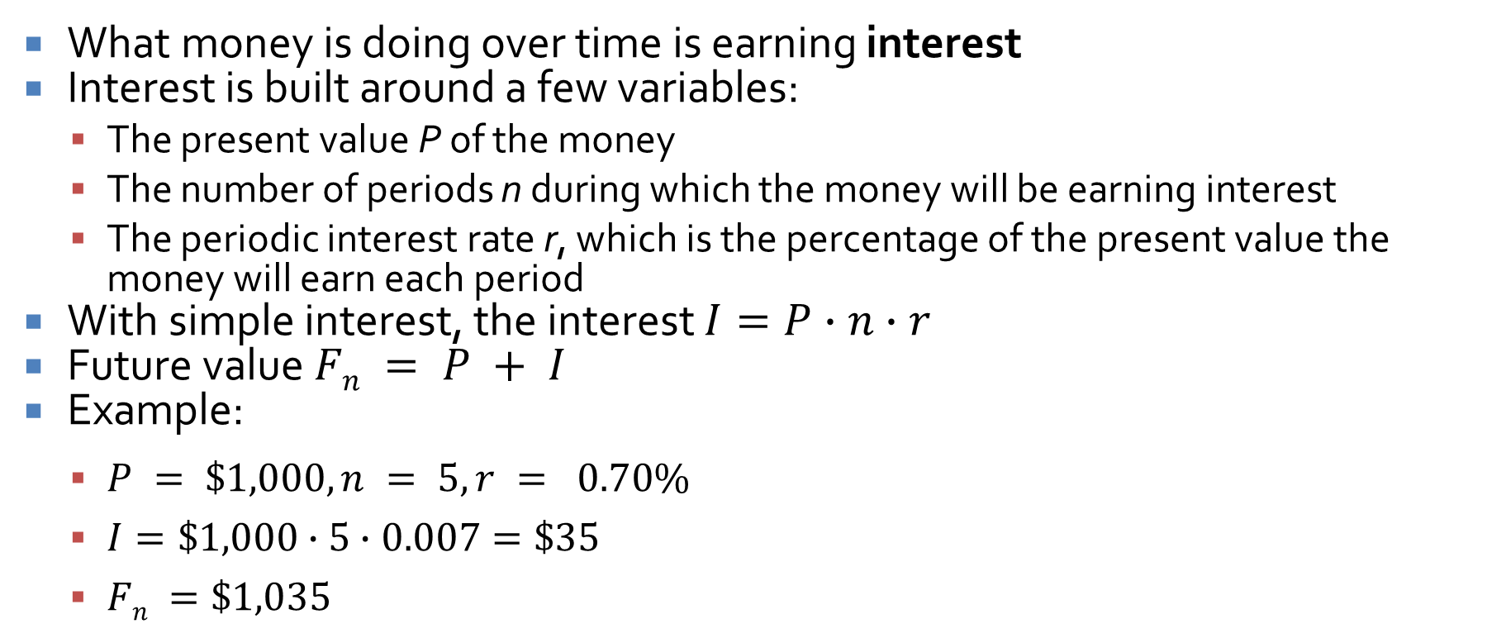
Simple interest
What money is doing over time is earning interest
Interest is built around a few variables:
  The present value P of the money
  The number of periods n during which the money will be earning interest
  The periodic interest rate r, which is the percentage of the present value the money will earn each period
With simple interest, the interest $I=P∙n∙r$
Future value $Fn = P + I$
Example:
  $P = \$1,000, n = 5, r = 0.70\%$
  $I=\$1,000∙5∙0.007=\$35$
  $Fn =\$1,035$

Slide 109
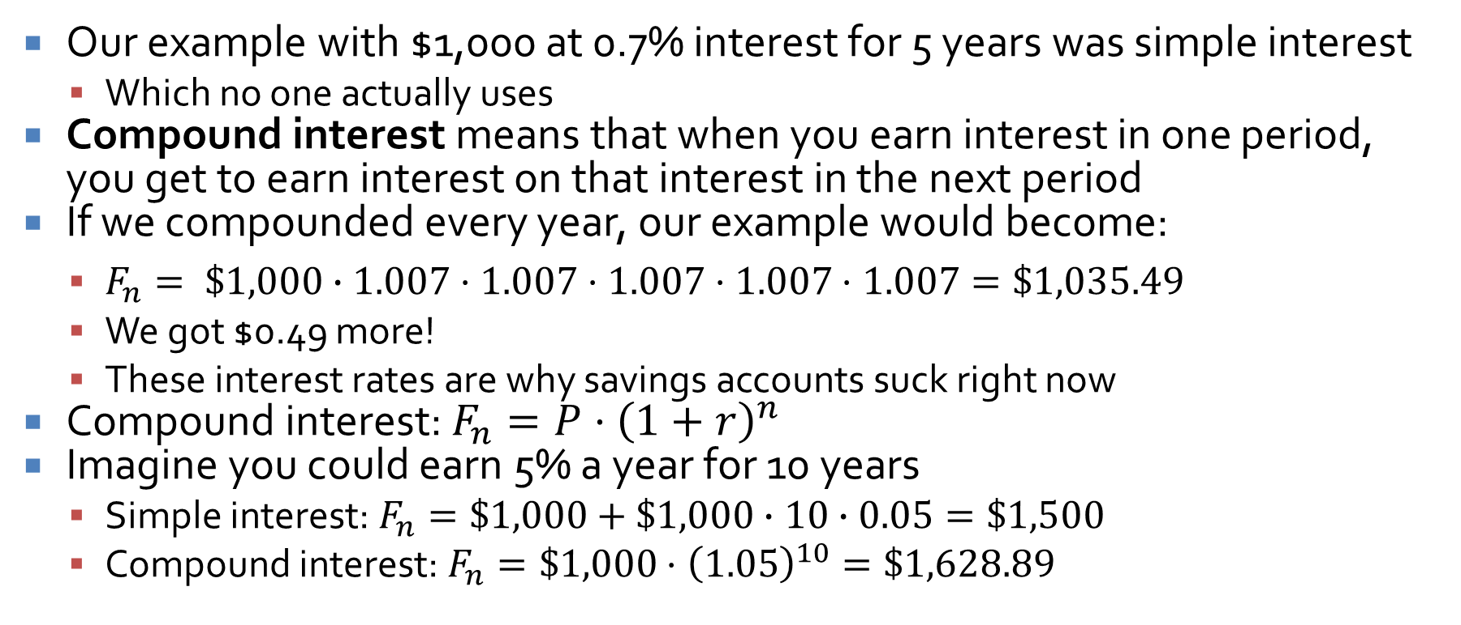
Compound interest
Our example with $1,000 at 0.7% interest for 5 years was simple interest
  Which no one actually uses
Compound interest means that when you earn interest in one period, you get to earn interest on that interest in the next period
If we compounded every year, our example would become:
  $F_{n}= \$1,000∙1.007⋅1.007⋅1.007⋅1.007⋅1.007=\$1,035.49$
  We got $0.49 more!
  These interest rates are why savings accounts suck right now
Compound interest: $F_{n}=P⋅{\left(1+r\right)}^{n}$
Imagine you could earn 5% a year for 10 years
  Simple interest: $F_{n}=\$1,000+\$1,000∙10∙0.05=\$1,500$
  Compound interest: $F_{n}=\$1,000⋅{\left(1.05\right)}^{10}=\$1,628.89$

Slide 110
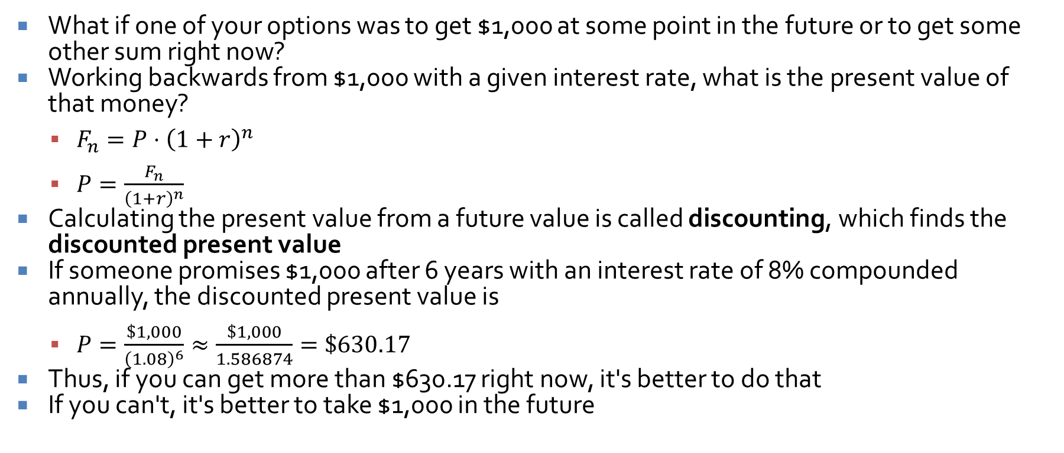
Discounted present value
What if one of your options was to get $1,000 at some point in the future or to get some other sum right now?
Working backwards from $1,000 with a given interest rate, what is the present value of that money?
  $F_{n}=P⋅{\left(1+r\right)}^{n}$
  $P=\frac{F_{n}}{{\left(1+r\right)}^{n}}$
Calculating the present value from a future value is called discounting, which finds the discounted present value
If someone promises $1,000 after 6 years with an interest rate of 8% compounded annually, the discounted present value is
  $P=\frac{\$1,000}{{\left(1.08\right)}^{6}}≈\frac{\$1,000}{1.586874}=\$630.17$
Thus, if you can get more than $630.17 right now, it's better to do that
If you can't, it's better to take $1,000 in the future

Slide 111
Example: buy or lease
Consider a server you need for a 3-year project
You have two options:
  Buy the server for $-4,000
  Lease it for four payments: $-1,000 now, $-1,000 in a year, $-1,100 in two years, and $-1,150 in three years at the end of the project
Naïve math says that $-4,000 is better than $-1,000 + $-1,000 + $-1,100 + $-1,150 = $-4,250
However, we can apply the discounted present value to those later payments (because we could have been investing that money)
As you can see in the table to the right, the discounted present value of $-3,943.52 is better than $-4,000
n | F_{n} | (1 + r)^{n} | F_{n} / (1 + r)^{n}
0 | -1000.00 | 1.00 | -1000.00
1 | -1000.00 | 1.05 | -952.38
2 | -1100.00 | 1.1025 | -997.73
3 | -1150.00 | 1.157625 | -993.41
 |  |  | -3943.52

Slide 112
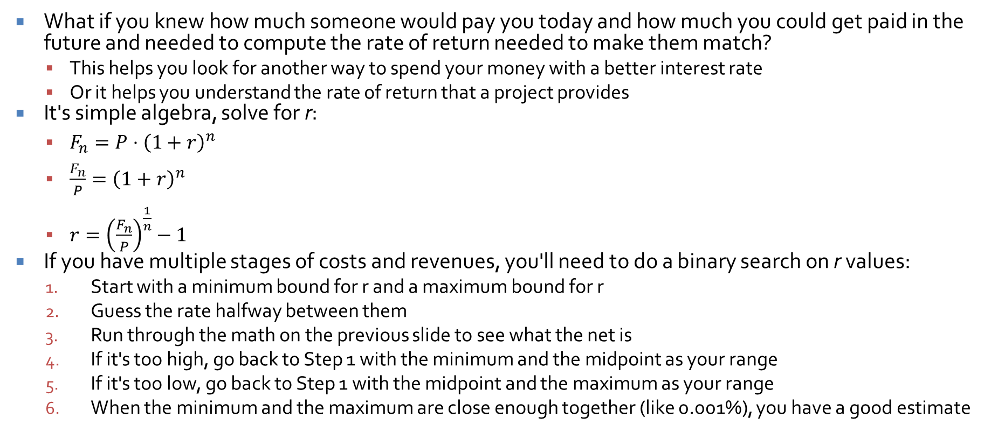
Internal rate of return
What if you knew how much someone would pay you today and how much you could get paid in the future and needed to compute the rate of return needed to make them match?
  This helps you look for another way to spend your money with a better interest rate
  Or it helps you understand the rate of return that a project provides
It's simple algebra, solve for r:
  $F_{n}=P⋅{\left(1+r\right)}^{n}$
  $\frac{F_{n}}{P}={\left(1+r\right)}^{n}$
  $r={\left(\frac{F_{n}}{P}\right)}^{\frac{1}{n}}−1$
If you have multiple stages of costs and revenues, you'll need to do a binary search on r values:
  Start with a minimum bound for r and a maximum bound for r
  Guess the rate halfway between them
  Run through the math on the previous slide to see what the net is
  If it's too high, go back to Step 1 with the minimum and the midpoint as your range
  If it's too low, go back to Step 1 with the midpoint and the maximum as your range
  When the minimum and the maximum are close enough together (like 0.001%), you have a good estimate

Slide 113
Uncertainty

Slide 114
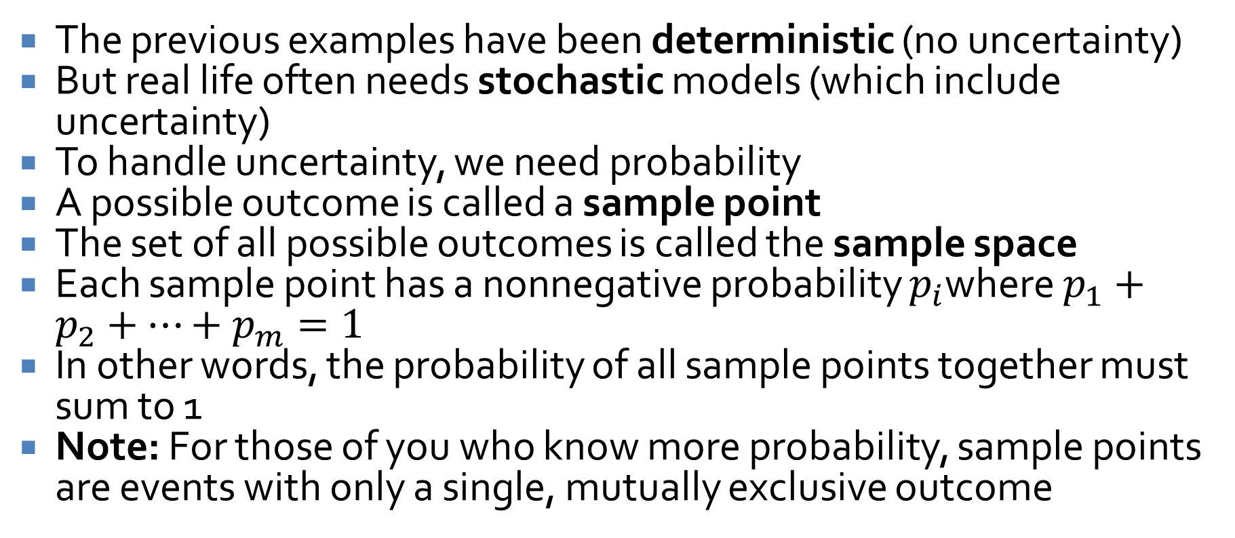
Uncertainty
The previous examples have been deterministic (no uncertainty)
But real life often needs stochastic models (which include uncertainty)
To handle uncertainty, we need probability
A possible outcome is called a sample point
The set of all possible outcomes is called the sample space
Each sample point has a nonnegative probability $p_{i}$where $p_{1}+p_{2}+…+p_{m}=1$
In other words, the probability of all sample points together must sum to 1
Note: For those of you who know more probability, sample points are events with only a single, mutually exclusive outcome

Slide 115
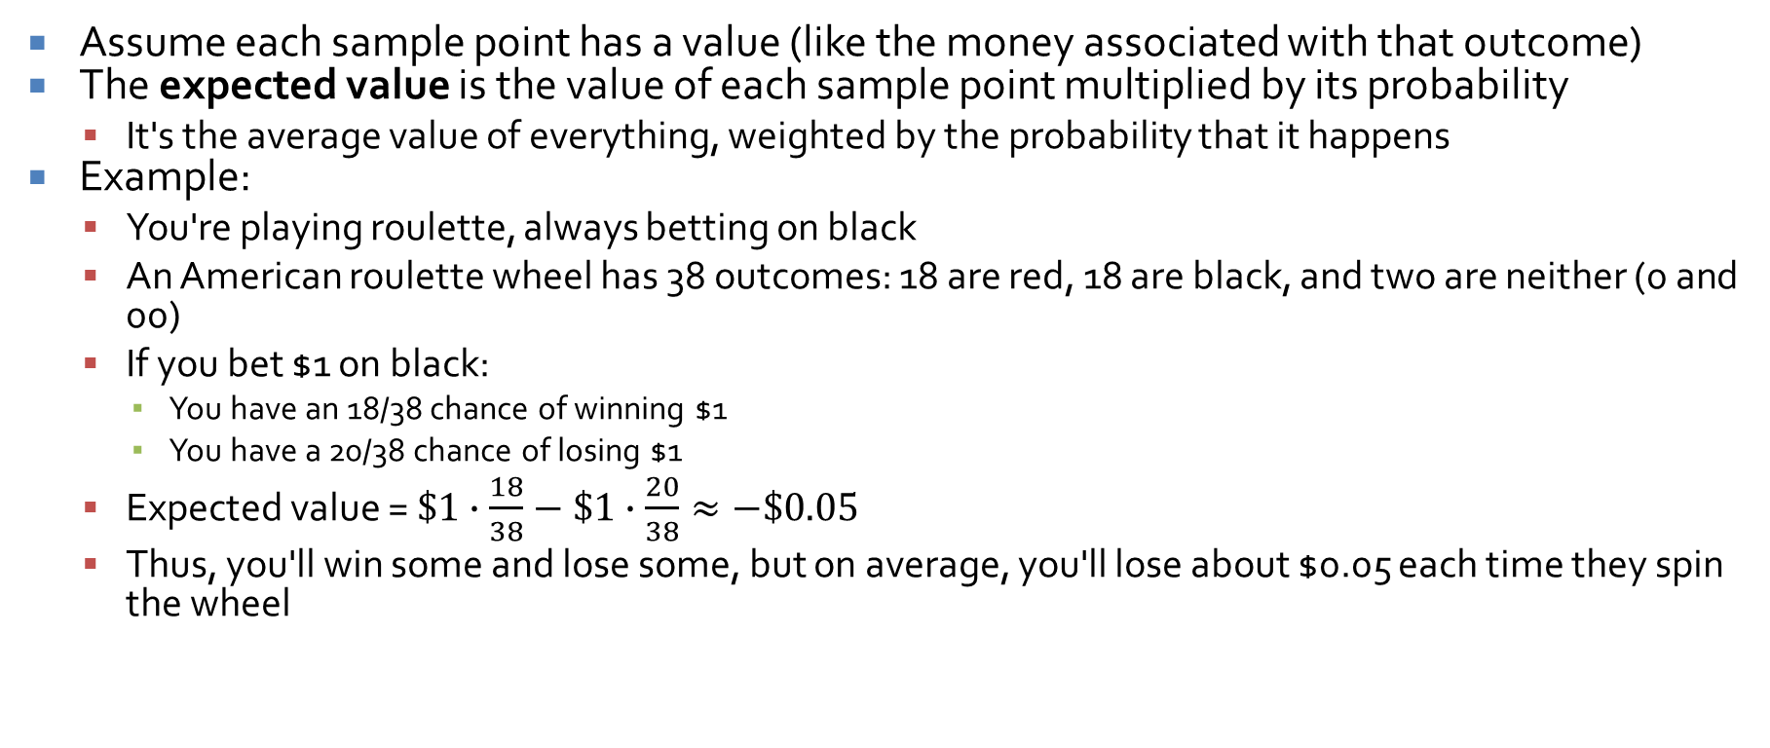
Expected value
Assume each sample point has a value (like the money associated with that outcome)
The expected value is the value of each sample point multiplied by its probability
  It's the average value of everything, weighted by the probability that it happens
Example:
  You're playing roulette, always betting on black
  An American roulette wheel has 38 outcomes: 18 are red, 18 are black, and two are neither (0 and 00)
  If you bet $1 on black:
    You have an 18/38 chance of winning $1
    You have a 20/38 chance of losing $1
  Expected value = $\$1∙\frac{18}{38}−\$1∙\frac{20}{38}≈−\$0.05$
  Thus, you'll win some and lose some, but on average, you'll lose about $0.05 each time they spin the wheel

Slide 116
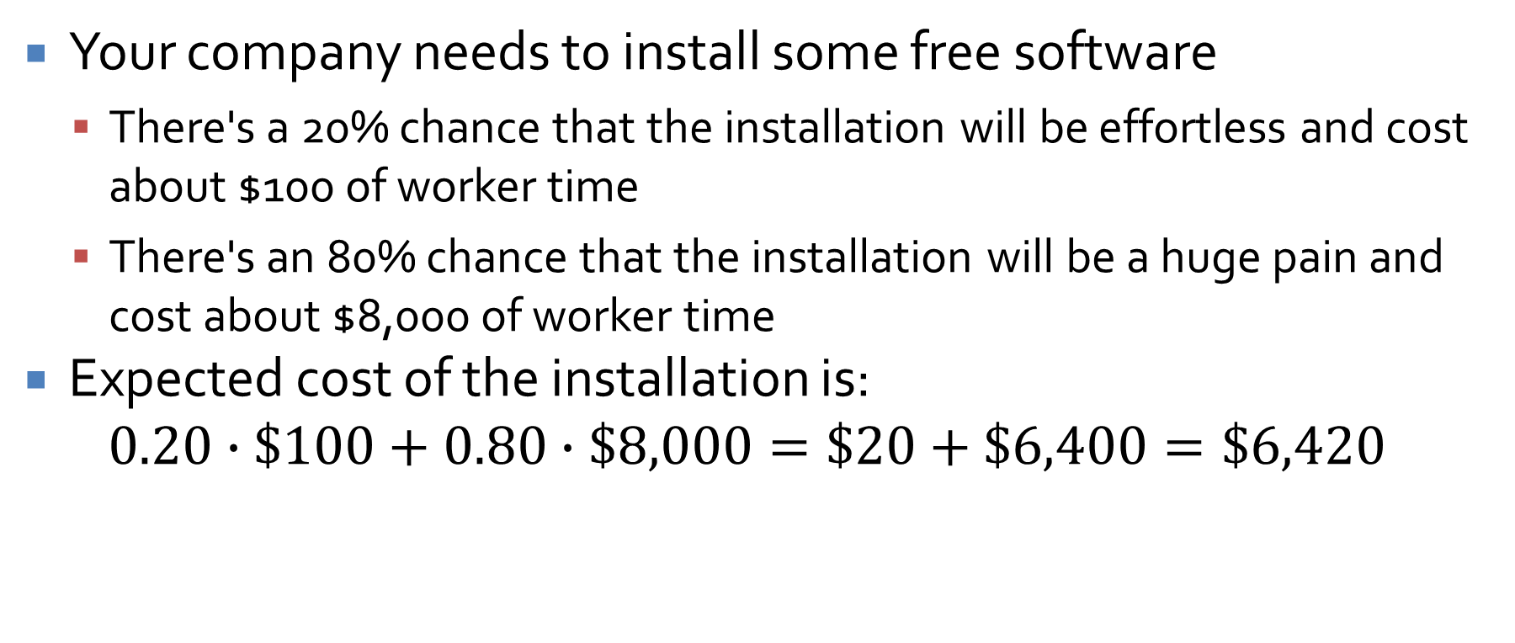
Simple example with uncertainty
Your company needs to install some free software
  There's a 20% chance that the installation will be effortless and cost about $100 of worker time
  There's an 80% chance that the installation will be a huge pain and cost about $8,000 of worker time
Expected cost of the installation is:
$$0.20∙\$100+0.80∙\$8,000=\$20+\$6,400=\$6,420$$

Slide 117
Scheduling

Slide 118
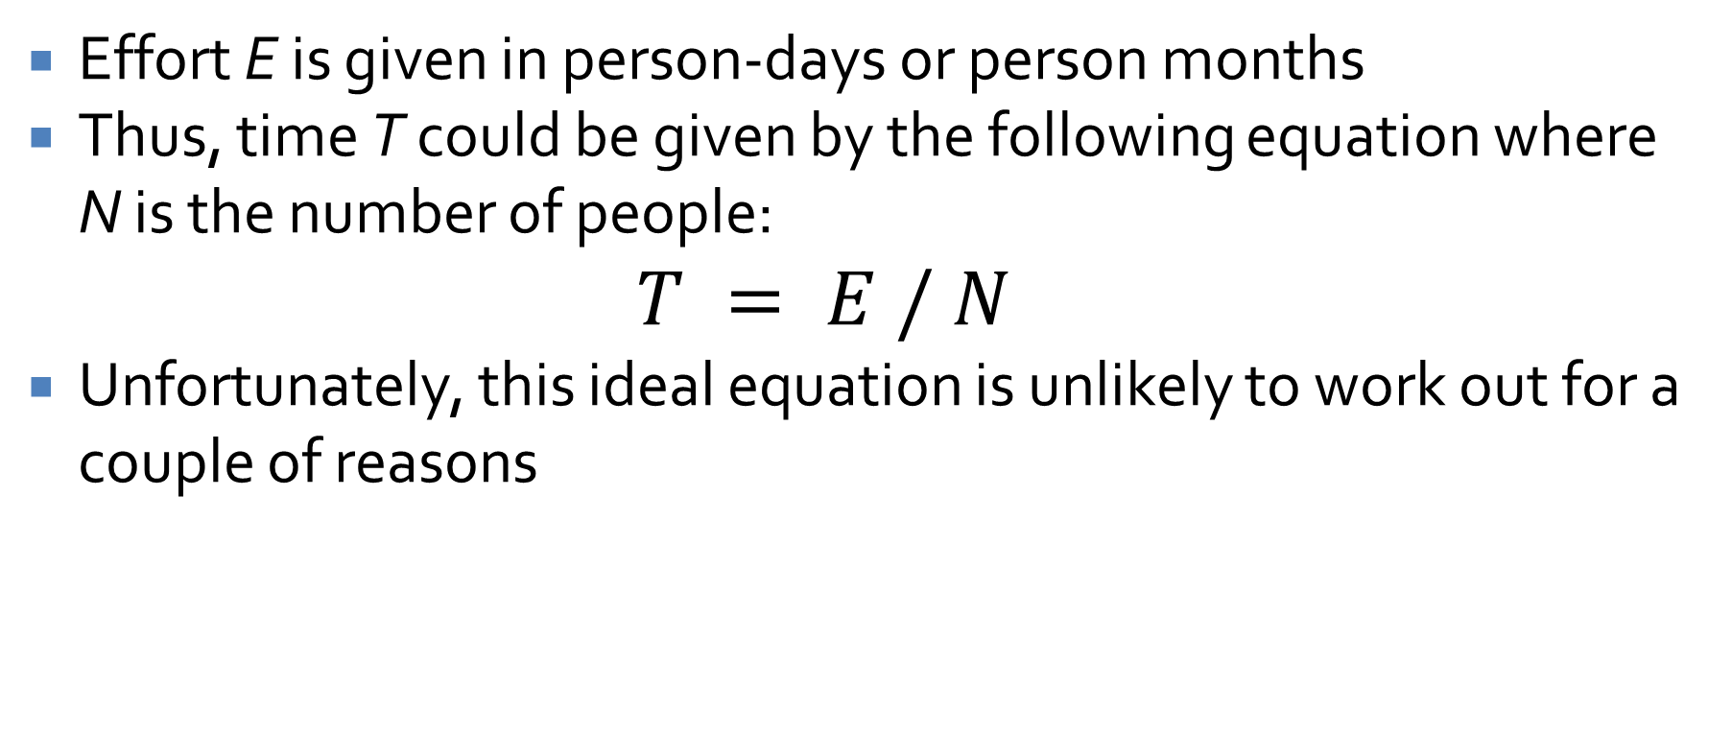
People
Effort E is given in person-days or person months
Thus, time T could be given by the following equation where N is the number of people:
  $$T = E / N$$
Unfortunately, this ideal equation is unlikely to work out for a couple of reasons

Slide 119
Details of tasks
Some tasks are easy to split up, and others are not
If it takes 5 minutes to pump up a bicycle tire, you can't do it 100 times faster by using 100 people instead of one
Small tasks can usually only be done by a single person at a time
Larger tasks generally obey the T = E / N rule, but there are diminishing returns for large values of N

Slide 120
Task dependencies
Looking at the time to do individual tasks isn't enough
Consider tasks A, B, and C with the following amounts of effort:
  A: 5 person-months
  B: 3 person-months
  C: 4 person-months
If we have three employees, one can work on each task
If the tasks are independent, the project will take 5 months to do, and tasks B and C can even run late without delaying the total project
What if C requires B to be done and B requires A to be done?
  If any task is delayed, the whole project will be delayed
  We have to share work on each task

Slide 121
Personnel capabilities
Some developers are better than others
  This messes with the overall T = E / N rule
Some developers have specialized in certain areas
  A tester might be great at testing but not so good at development
  Only one person on the team might have experience with GUIs
As a consequence, it might not be possible to have multiple people working on a given task, and one person might be needed for two different tasks
Agile methodologies supposedly improve these issues by trying to make everyone work on everything and grow their skills

Slide 122
Simplifying assumptions
We assume that we have a good estimate of the relationship between effort and time
We assume small tasks assigned to one person
We assume a dependency between two tasks if only one person has the skills needed to do both
  This allows us to look at the problem of specific skillsets as the more general problem of dependencies
With these assumptions, we can organize our tasks by duration and dependency

Slide 123
Dependency example
Task Number | Duration (Days) | Prerequisite Tasks
1 | 6 | -
2 | 5 | 1
3 | 2 | 1
4 | 6 | 1
5 | 4 | 2, 3
6 | 1 | 4
7 | 2 | 4
8 | 4 | 4
9 | 3 | 2
10 | 4 | 5, 6
11 | 1 | 7, 8
12 | 4 | 9, 10
13 | 2 | 6, 11
14 | 1 | 12, 13
The following example shows 14 tasks
  The time for each task is given
  The prerequisite tasks that must be done first are listed too
  Tasks are numbered so that higher number tasks are dependent on lower number tasks
This way of formatting the information doesn't make it easy to figure out several things we want to know:
  How long the whole project will take
  Critical tasks, the ones that determine the minimum time for the project
  Slack (or float), the amount of time non-critical tasks can slip without delaying the project

Slide 124
Gantt charts
Gantt charts let us find total time, critical tasks, and float times
  Tasks are represented as rectangles with length proportional to duration
  Dependencies between tasks are arrows
  Time increases from left to right
  We put the task starts as early as possible, immediately after their last prerequisite finishes

Slide 125
Full Gantt chart
0 5 10 15 20 25
Time
1
2
3
4
5
6
7
8
9
10
11
12
13
14
Here is the full Gantt chart
People don't always draw the arrows, but we're doing so here to be explicit
Looking carefully at the chart, it's clear that the project will take 24 days

Slide 126
Critical tasks
0 5 10 15 20 25
Time
1
2
3
4
5
6
7
8
9
10
11
12
13
14
We can find the critical tasks by working backward from the task(s) with the latest finish time
Whichever of its predecessors have the latest end time are also critical
If any of these are delayed, the whole project will be delayed

Slide 127
Slack time
0 5 10 15 20 25
Time
1
2
3
4
5
6
7
8
9
10
11
12
13
14
Non-critical tasks have slack, an amount of time they can slip by and still not delay the project
Horizontal arrows show slack times:
  Task 3: 3 units
  Task 6: 2 units
  Task 7: 6 units
    Tricky! It's 6 because that's what's needed before a critical task will be delayed
  Task 9: 5 units
  Task 13: 4 units

Slide 128
Critical path methods
Computer scientists love to use computer science for everything, even project management problems
In addition to Gantt charts, similar information can be represented using graphs
  Then, graph theory tools can be applied to the information
These approaches are called critical path methods (CPM) because they focus on making the critical path as short as possible

Slide 129
More on critical path
An important idea that critical path methods add to the mix is a tradeoff between time and cost
Each task has:
  A normal time that the task would take
  A crash time which is the fastest a task could possibly be done by spending more resources
  A (usually linear) relationship between putting resources in and getting the task done quicker
By using linear programming, a technique for finding optimal solutions to linear systems of equations, the cheapest way to finish a project by a given deadline could be determined
  Maybe rushing Task 7 is worth the extra money but rushing Task 10 isn't

Slide 130
Nodes in a CPM graph
The CPM we will talk about has nodes containing seven pieces of information, written in a peculiar way
  ID: Task identifier
  D: Task duration
  ES: Earliest start time
  EF: Earliest finish time
  LS: Latest start time
  LF: Latest finish time
  S: Slack
D
ES | ID | EF
LS |  | LF
S

Slide 131
Graph showing dependencies
5
 | 2
3
 | 9
4
 | 5
1
 | 6
4
 | 10
4
 | 12
6
 | 1
2
 | 3
1
 | 14
2
 | 7
2
 | 13
6
 | 4
1
 | 11
4
 | 8

Slide 132
Earliest start and finish times
Every task with no prerequisite has an ES of 0
For a task with prerequisites, its ES is the maximum EF of all of its prerequisites
For each task, EF = ES + D
Using these relationships, we can fill in the ES and EF for each task, starting from those with no prerequisites and working through the rest of the graph

Slide 133
Graph with earliest start and finish times
5
6 | 2 | 11
3
11 | 9 | 14
4
11 | 5 | 15
1
12 | 6 | 13
4
15 | 10 | 19
4
19 | 12 | 23
6
0 | 1 | 6
2
6 | 3 | 8
1
23 | 14 | 24
2
12 | 7 | 14
2
17 | 13 | 19
6
6 | 4 | 12
1
16 | 11 | 17
4
12 | 8 | 16

Slide 134
Latest start and finish times
Every task that isn't the prerequisite for anything has an LF = EF
For a task that is the prerequisite for something, its LF is the minimum LS of the tasks it’s a prerequisite for
For each task, LS = LF - D
Using these relationships, we can fill in the LF and LS for each task, starting from those that aren't the prerequisites for anything and working through the rest of the graph

Slide 135
Graph with all start and finish times
5
6 | 2 | 11
6 |  | 11
3
11 | 9 | 14
16 |  | 19
4
11 | 5 | 15
11 |  | 15
1
12 | 6 | 13
14 |  | 15
4
15 | 10 | 19
15 |  | 19
4
19 | 12 | 23
19 |  | 23
6
0 | 1 | 6
0 |  | 6
2
6 | 3 | 8
9 |  | 11
1
23 | 14 | 24
23 |  | 24
2
12 | 7 | 14
18 |  | 20
2
17 | 13 | 19
21 |  | 23
6
6 | 4 | 12
8 |  | 14
1
16 | 11 | 17
20 |  | 21
4
12 | 8 | 16
16 |  | 20

Slide 136
Slack
For each task, the slack time S = LF – EF
We can run through the graph and mark that as well
Nodes with no slack are on the critical path

Slide 137
Final graph with slack
5
6 | 2 | 11
6 |  | 11
0
3
11 | 9 | 14
16 |  | 19
5
4
11 | 5 | 15
11 |  | 15
0
1
12 | 6 | 13
14 |  | 15
2
4
15 | 10 | 19
15 |  | 19
0
4
19 | 12 | 23
19 |  | 23
0
6
0 | 1 | 6
0 |  | 6
0
2
6 | 3 | 8
9 |  | 11
3
1
23 | 14 | 24
23 |  | 24
0
2
12 | 7 | 14
18 |  | 20
6
2
17 | 13 | 19
21 |  | 23
4
6
6 | 4 | 12
8 |  | 14
2
1
16 | 11 | 17
20 |  | 21
4
4
12 | 8 | 16
16 |  | 20
4

Slide 138
Execution and Control

Slide 139
Control in traditional projects
Managers have to track progress
  If a task is done early (sometimes it happens!), the project is ahead of schedule
  If a task is done late, the project is behind schedule
  Similarly, cost might be above or below expectations
If progress doesn't meet expectations, actions must be taken:
  Reduce the features but stay on schedule
  Add more resources (people) but stay on schedule
  Delay the delivery date, which probably also increases costs
  Reduce costs by shrinking the scope, firing people or shortening the delivery date or both

Slide 140
Back to the iron triangle
There's a graphical depiction of project management used imply relationships between time, scope, cost, and quality
This triangle is intended to indicate that you can't change scope, time, or cost without affecting the other two (at least if you want to maintain quality)
Increasing scope means increasing time or cost (or both)
It's obvious, but manager are sometimes tempted to push workers to work faster, for example, pretending there are no consequences
Scope
Quality
Time
Cost

Slide 141
Brooks' Law
Fred Brooks is a Turing Award-winning computer scientist who wrote The Mythical Man-Month, a book about software engineering
Brooks' Law: "Adding programmers to a late project makes it later."
  New people have to be trained on the project by existing employees
  This effect gets worse with projects that are close to done since there's more to learn
There are also lower bounds on how fast a project can get done no matter how many people you throw at it
  Some tasks can only be done effectively by a single person
Presumably, there's an ideal team size for a given project, but we do not (yet) know how to estimate it

Slide 142
Consulting with stakeholders
Stakeholders get mad when bad news is sprung on them at the last minute
  Product will be delayed
  Product won't do what it's expected to do
  Product will cost more than expected
When problems arise, managers should consult with stakeholders to see how they want to proceed
People prefer having input into the response to a bad situation

Slide 143
Earned value management
If a job is expected to take 100 hours, and you've worked for 50, are you halfway done?
  Probably not!
Earned value management (EVM) (or earned value analysis (EVA)) tries to solve this problem
  Progress is how much of the overall project is complete
  Health is a comparison of how much you thought you'd get done with how much you did get done
  Value can be measured in person-days or in dollars

Slide 144
More on EVM
We have talked about ways to decompose a project into tasks and how to estimate the effort or cost 0f each task (even if that's still a hard problem)
  Planned value (PV) is the estimated cost of a given task
Using a Gantt chart or CPM, you can make a schedule for all of your tasks
  Planned duration (PD) is the estimated time for the entire project
With the PV for every task and a schedule, you can graph the growth of PV over time
This line ends at the PD, giving the Budget At Completion (BAC), the estimated cost of the whole project

Slide 145
Earned value and actual cost
We can map out PV before the project is really underway
While the project is going, we're interested in two more values for each point in time:
  Earned value (EV): The planned value of the tasks that are done
  Actual cost (AC): The effort or money spent on getting those tasks done
It seems strange that we can have three different values for each point in time, but what we plan to do differs from what we get done, and what we get done doesn't always cost what we think it will

Slide 146
Earned value management with PV, EV, and AC
The graph below shows an example of relationships between PV, EV, and AC

Slide 147
Quantifying project problems
Where the EV is relative to the PV shows how much has been gotten done relative to what was planned
  If the EV line is below the PV, the project is behind
  If the EV line is above the PV, the project is ahead
Where the AC is relative to the EV shows how much value has been expended relative to how much value was completed
  If the AC is above the EV, the project is over budget
  If the AC is below the EV, the project is under budget

Slide 148
More on quantifying project problems
The Schedule Performance Index (SPI) is EV/PV
  When SPI = 1, the project is right on schedule
  When SPI < 1, the project is behind schedule
  When SPI > 1, the project is ahead of schedule
  Example: Here, the SPI = 360/400 = 0.9, meaning behind schedule
The Cost Performance Index (CPI) is EV/AC
  When CPI = 1, the project is right on budget
  When CPI < 1, the project is over budget
  When CPI > 1, the project is under budget
  Example: Here, the CPI = 360/378.94 = 0.95, meaning over budget

Slide 149
Even more on quantifying project problems
Using these numbers, we can predict how well the project is doing
Forecast Project Duration (FPD) is PD/SPI = PD/(EV/PV)
  The FPD estimates the true project duration based on how far or ahead the project is at a given time
  Example: In this case, assuming a planned duration of 30 months, FPD = 30/0.9 = 33.33 months
Estimate At Completion (EAC) is BAC/CPI = BAC/(EV/AC)
  The EAC estimates the true project cost based on how much it has cost to get tasks done so far
  Example: In this case, assuming a budget at completion of 1140 (whatevers), EAC = 1140/0.95 = 1200
Using these estimates and EVM charts, managers can make decisions about what to do when things are going wrong

Slide 150
Control in Scrum
Everything revolves around sprints in Scrum
We measure progress against the amount of work to be done using burn charts
Burn charts have a vertical axis of work and a horizontal axis of time
  Burn up charts show work completed and are more often used to track progress on full projects or releases
  Burn down charts show work remaining and are more often used to track progress within a sprint

Slide 151
Burn up chart example
This burn up chart shows progress over a whole project
  13 sprints are planned
Solid black lines show real progress against planned progress
The horizontal lines on the left show estimates of total story points needed for the project
  They were revised up from about 350 to 450 over time
Although velocity is improving, we'll probably have to add sprints or reduce features

Slide 152
Burn down chart example
This burn down chart shows progress made during a three-week sprint
Each dot shows the completion of a PBI
As before, the solid line shows real progress against the dotted line of planned progress
If all the story points had been finished early, the team could work with the PO to add more to the sprint backlog
If some PBIs had not been completed, they go back to the product backlog

Slide 153
Task boards
Task boards are boards showing the current status of all tasks for a sprint
Tasks are often shown in rows corresponding to a PBI
  Columns might be: To Do, In Progress, In Testing, Done, and similar
Your Trello boards are approximations of the task boards people use in real development
Tasks boards are not as analytical as burn charts, but they can help in other ways:
  Too many things in the To Do column late in a sprint means that PBIs aren't all going to get done
  Something stuck in the In Progress column for a while means that more developers should help with it
  If it looks like some PBIs are impossible to finish this sprint, the team can focus on tasks to get PBIs done that are possible

Slide 154
Quiz

Slide 155
Upcoming

Slide 156
Next time…
Project 4 is due on Friday!
  You have until 11:59 p.m. to turn in all your code
  But you have to demo your project online in class
Assignment 4 is also due Friday!

Slide 157
Reminders
Fill out course evaluations!
Finish Project 4
Don't forget Assignment 4
Final Exam:
  Next Friday, 12/13/2024
  2:45 - 4:45 p.m.

